Slide 1
Introduction to 4Cs
Longview school

Slide 2
4Cs Rich Professional Learning
Objective of Longview PLTS:
WCPSS Balanced Assessment System
To develop and implement a balanced assessment system that accurately reflects students’ knowledge of core curriculum standards as well as the ability to collaborate, be creative, communicate, and think critically
Competencies for the 4Cs: Define and Communicate Standards for Collaboration, Creativity, Communication, and Critical Thinking
Balanced Pre-K-12 Assessment Framework: Create a balanced PreK-12 district assessment framework to include measurement of the 4Cs
PreK-12 Digital Portfolio Solution: Develop and deploy a digital portfolio platform to house work samples demonstrating student growth on 4Cs competencies

Slide 3
How do I implement the 4Cs in my class?
How do the 4Cs connect to Blended Learning?
How will I be assessed on the 4Cs?

Slide 4
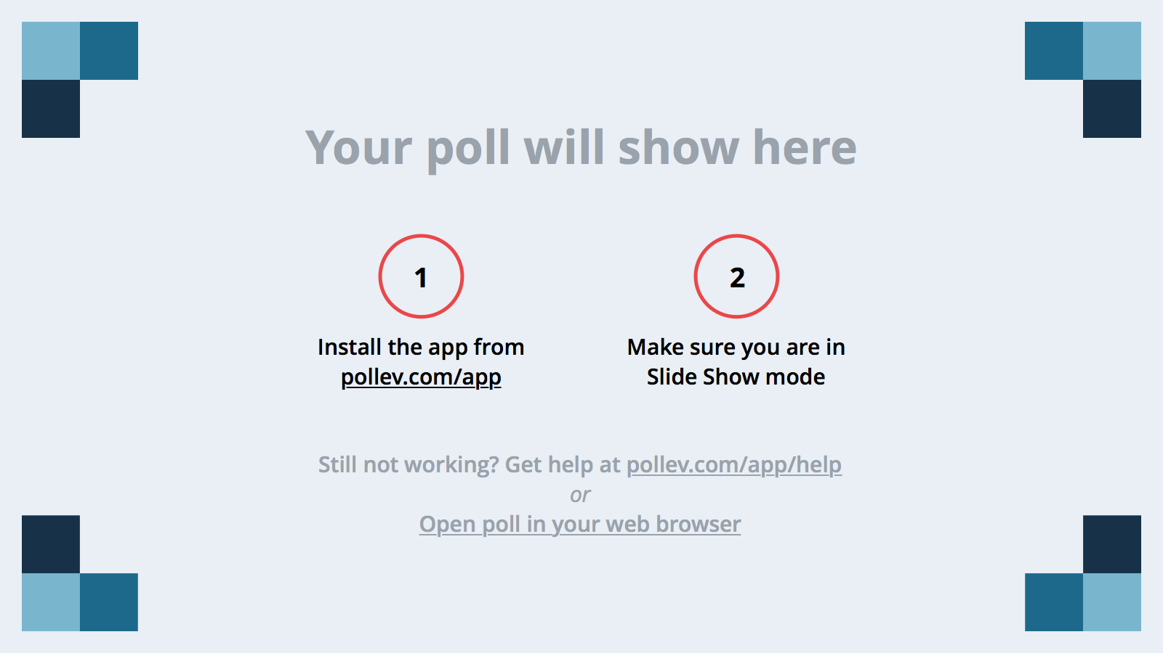
Notes:
Poll Title: What are the 4Cs? https://www.polleverywhere.com/multiple_choice_polls/Hb7RbbRrYDBheX9

Slide 5
Notes:
Poll Title: How comfortable are you with using the 4Cs in the classroom? https://www.polleverywhere.com/multiple_choice_polls/KySflIWF5Apwq20

Slide 6
Notes:
Poll Title: Which of the 4Cs do you understand the most? https://www.polleverywhere.com/multiple_choice_polls/VlsWraY2r0UjAzs

Slide 7
Notes:
Poll Title: Which of the 4Cs do you use the most in practice? https://www.polleverywhere.com/multiple_choice_polls/JvZGaUpBDm39x84

Slide 8
Notes:
Poll Title: Which of the 4Cs do you understand the least? https://www.polleverywhere.com/multiple_choice_polls/wkAz0JIGCcHj2Hf

Slide 9
Notes:
Poll Title: Which of the 4Cs do you practice the least? https://www.polleverywhere.com/multiple_choice_polls/BY06D6bcFMjJ48K

Slide 10
Notes:
Poll Title: Rank the importance of each 4C to you. https://www.polleverywhere.com/ranking_polls/SrsYP07azN2LEJo

Slide 11
Notes:
Poll Title: In reference to implementing the 4Cs in your classroom, what more can I do to assist you? https://www.polleverywhere.com/free_text_polls/2oIhGv1zTzvbNHQ

Slide 12
Have questions
or feedback?
Go to:
longviewschoolplt.weebly.com
And click on the blog!

